Slide 1
POP THE PROBLEM

Slide 2
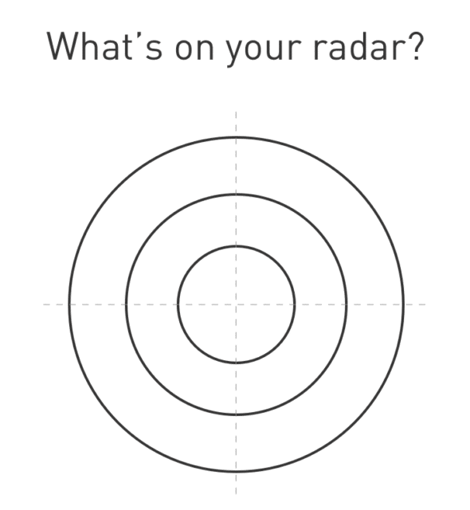

Slide 3
Gravity Problems
Zoom in to target problems that we can tackle together with compassionate design thinking
Notes:
Tie in the problems too big for us to tackle with prototyping. Design Your Life book.
>Problem: Name & describe why some of the problems are effectively inactionable for you, and therefore need to be accepted.
>Reframe: identify and describe a new, more actionable problem to replace your old gravity problem
>Bias to action: list some ideas or some small step(s) you could take to respond to your reframe.

Slide 4
What is outside of my control?
Notes:
Locus of control & influence

Slide 5
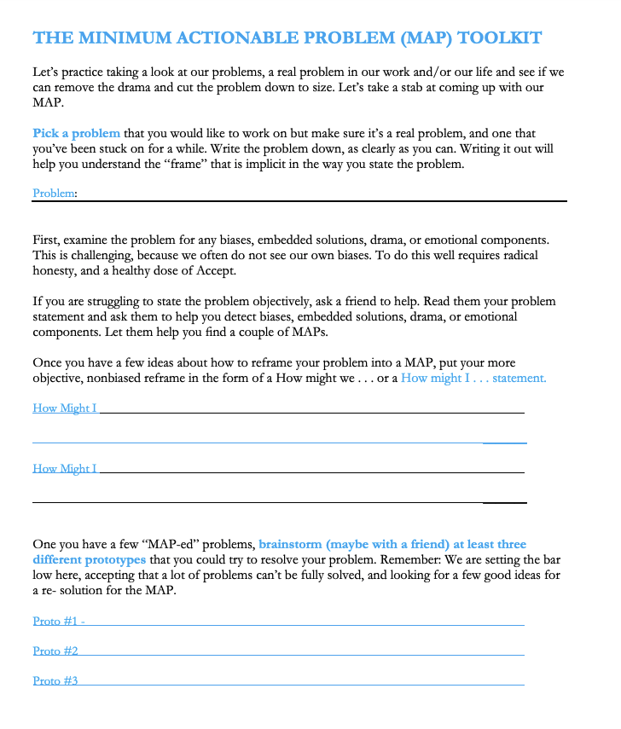

Slide 6

Loss frame - could we shift our view to build on the positive instead?
Notes:
Idea: getting out of the negatives; rehearse and practice good news & gratitude

Slide 7
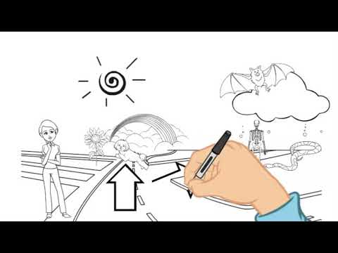
Positive reappraisal
Notes:
Key aspect of resilience building

